Slide 1
Autism Spectrum Disorders
The Faces of Autism
Notes:
Temple Grandin, Ph.D., is the most accomplished and well-known adult with autism in the world.

Slide 2
What is Autism?
A broad group of neurological disorders.
Characterized by severe and pervasive impairment in several areas of development:
Social interaction skills
Communication skills
The presence of stereotyped behavior, interest, and activities.
Indicators of autism typically appear by age 2 or 3.
Notes:
Neurophysiological Disorders
not to a specific location in the brain but suggest that autism is due to connection abnormalities between neural networks that process information.

Slide 3
Autism is not…
a disease.
curable. Autism is a life-long condition.

Slide 4
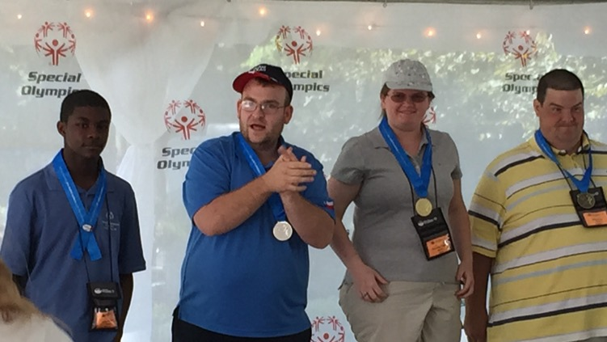
Individuals with autism…
can live successful lives and be contributing members of society.
can show love and affection, in their own way.

Slide 5
Challenges
Theory of Mind – A social-cognitive skill that allows an individual to understand what someone else is thinking or feeling.
The term ‘autism’ is derived from the Greek work ‘autos’ or self.

Slide 6
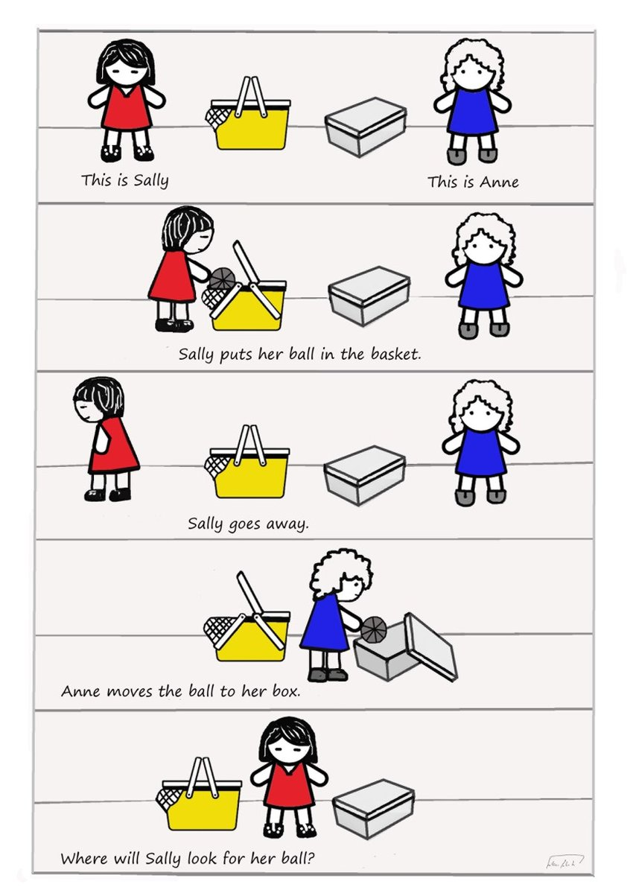

Slide 7
Challenges
Theory of Mind – A social-cognitive skill allow an individual to understand what someone else is thinking or feeling.
Verbal & Non-verbal communication

Slide 8
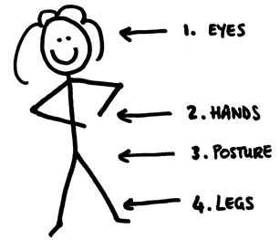
Verbal, visual, vocal
Three elements effect our overall opinion of a message concerning feelings:
words account for 7%,
tone of voice accounts for 38%,
body language accounts for 55%.
Notes:
For example, we see an incongruence in verbal and non-verbal communication.
Verbal: "I do not have a problem with you!"
Non-verbal: person avoids eye-contact, looks anxious, has a closed body language, etc.

Slide 9
I didn’t say she stole my money.

Slide 10
Prevalence
once considered rare
In the U.S., the Centers for Disease Control
2001 - 1 in 500
2009 - 1 in 100
2018 – 1 in 59
4 times more prevalent in boys

Slide 11
Causes and Prevention
Unknown (neurologically based)
Genetic predisposition
Identification:
Checklist for Autism in Toddlers (CHAT)
Joint attention

Slide 12
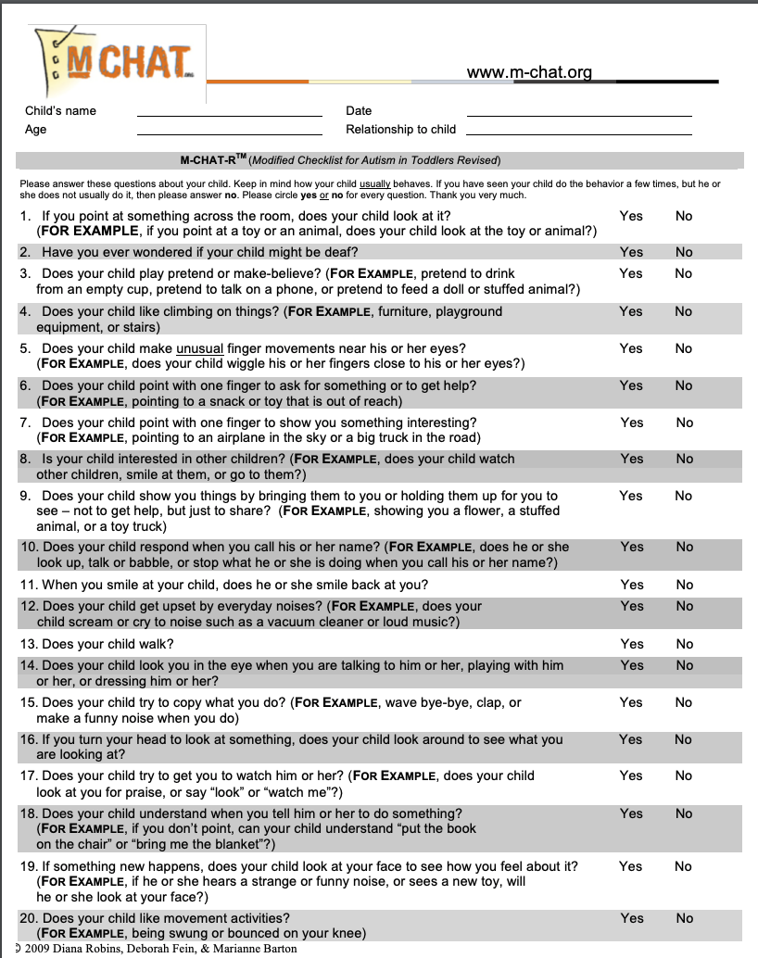

Slide 13
Intervention
Early Intervention
Communication skills
Structured Environment
Predictability & Routine
Functional Behavior Analysis
Methods
Applied Behavior Analysis (ABA)
TEACCH Shoebox Tasks

Slide 14
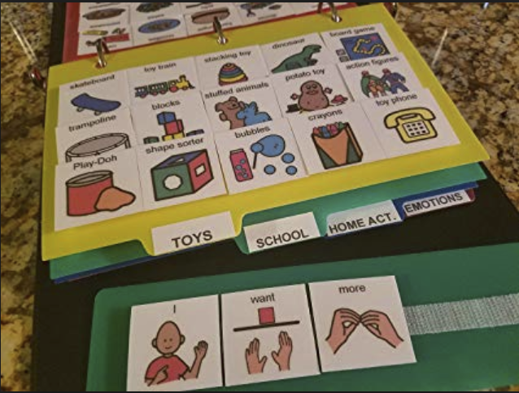

Slide 15
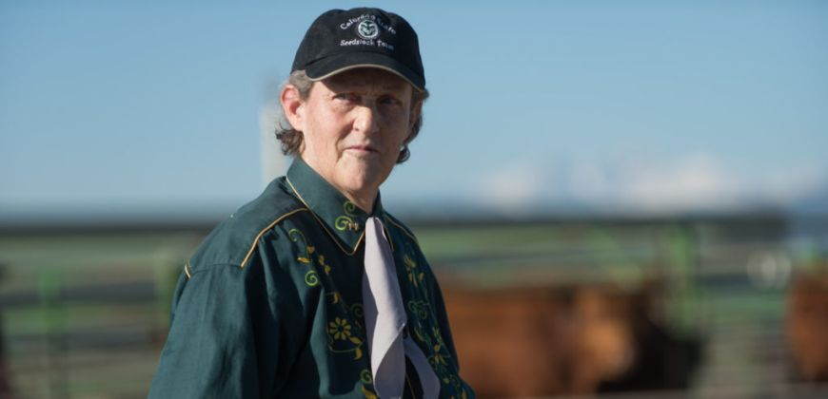
I am different, not less.
- Dr. Temple Grandin
Notes:
Dr. Temple Grandin, Colorado State University professor of animal sciences and world-renowned autism spokesperson, has been named to the National Women’s Hall of Fame. A professor of animal sciences for more than 20 years, Grandin has made enormous contributions to the livestock industry. Her autism allows her to think in pictures, and that ability has made her a visionary in her field. Her insights into animal behavior shaped innovative approaches to livestock handling, including methods and designs for humane slaughter that have become the industry standard.

