Slide 1
Individuals with Special Needs
Dr. Karen Walker

Slide 2
An individual with special needs requires assistance for disabilities that may be
mental,
emotional, or
physical.

Slide 3
Often an individual with special needs struggles with
Social Skills
Communication
Sensory Issues

Slide 4
Social Skills
Cultural expectations
Personal space
Facial expressions and social cues
Eye contact
Theory of Mind – A social-cognitive skill that allows an individual to understand what someone else is thinking or feeling.

Slide 5
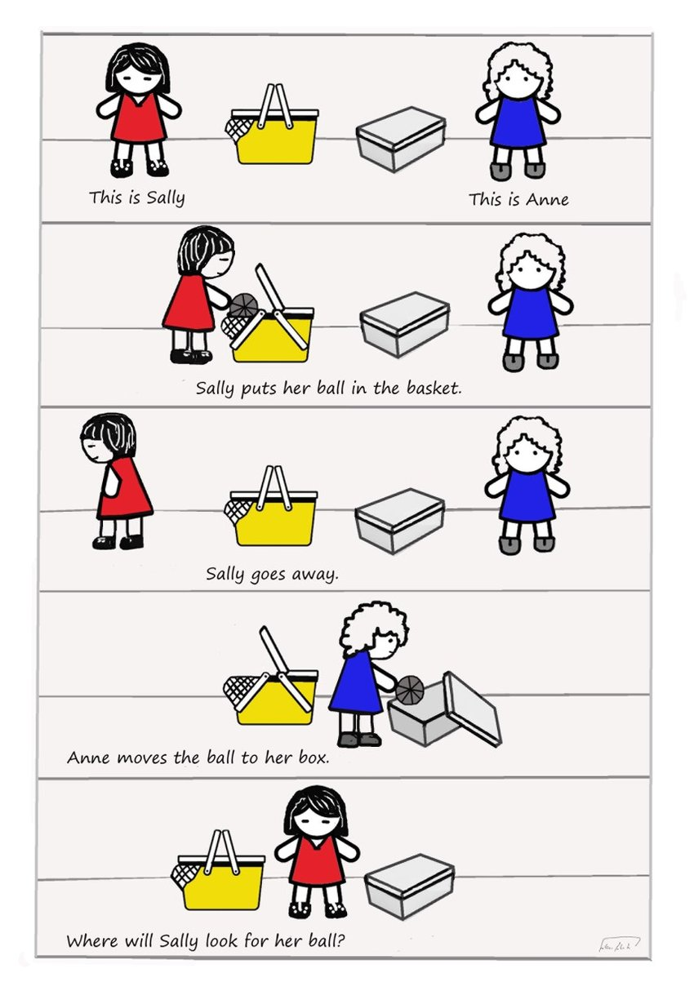

Slide 6
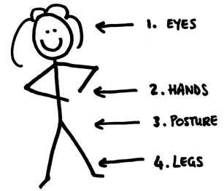
Communication
Greeting
Conversation turn-taking
Non-verbal
Eye contact
Response time

Slide 7
Sensory Issues

Slide 8
How families can help…
Awareness – what challenges your loved one?
Practice social situations – what are cultural expectations?
Plan for the unexpected
Rehearse greetings and appropriate responses
Eliminate or avoid sensory triggers
Create a calm atmosphere
Have patience

