Slide 1
Learning disabilities, accommodations and inclusion
Understanding how to create success in the classroom by understanding learning disabilities, accommodations, and inclusion to help boost teacher and student success.

Slide 2
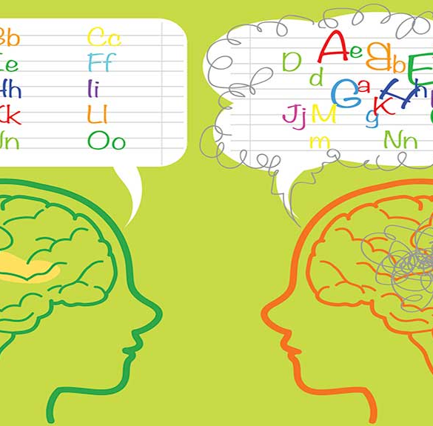
What is a learning disability?
A learning disability is when a person’s brain is wired differently than others. They learn and understand materials in a different way than most. They are just as smart as others, they just see and think about things differently.

Slide 3
For example….. Getting to 10
Make an equation (adding) that equals 10.
This Photo by Unknown Author is licensed under CC BY

Slide 4
How did you Get to 10?
2+8 *2+2+2+4
5+5
3+7
6+4

Slide 5
areas of learning disabilities
Reading
Writing
Math

Slide 6
Types of reading disabilities
Reading comprehension
Reading fluency
Basic reading-Dyslexia

Slide 7
Reading disability
Reading disability affects the learner's ability to…..
Understand the meaning of words and passages
Basic reading skills such as
decoding words
comprehension
fluency
Signs of reading disability
Reads words with no difficulty, but doesn’t remember or understand what they read
No feelings or change in tone when reading
No rhythm or pace
No logical phrasing
This Photo by Unknown Author is licensed under CC BY
https://www.verywellfamily.com/learning-disability-in-reading-comprehension-2162449-Source

Slide 8
Reading comprehension
occurs at three different times, It occurs before, during and after a person reads an article or a passage
Being able to read and understand the words that were just read
processes what was just read and being able to understand it and integrate it with other information that you already know.
https://www.k12reader.com/what-is-reading-comprehension/ Source

Slide 9
Reading fluency
the ability to read with accuracy, proper expression and speed.
https://youtu.be/LPZixxaSNXg

Slide 10
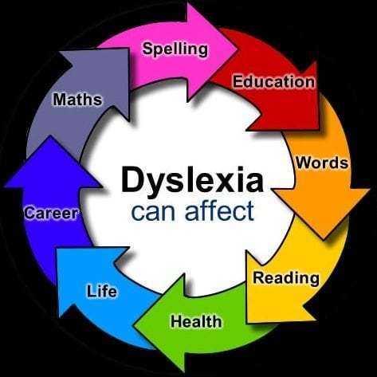
Basic reading-dyslexia
“Dyslexia” means a difficulty in learning to read, write and spell despite conventional instruction, having an Average IQ, and sociocultural opportunity.
Signs of dyslexia
Struggles with……..
phonological awareness
sounds-symbol association
Syntax
Reading comprehension
Reading fluency
Source-The dyslexia handbook, 2018
This Photo by Unknown Author is licensed under CC BY-SA-NC

Slide 11
Written expression Disabilities
Dysgraphia

Slide 12
What is Dysgraphia?
a learning disability that affects handwriting and fine motor skills.
It interferes with spelling, word spacing, and the general ability to put thoughts on paper.
It makes the process of writing laboriously slow, and the written product difficult to read.
Read more: http://www.minddisorders.com/Del-Fi/Disorder-of-written-expression.html#ixzz5veiuJLX5

Slide 13
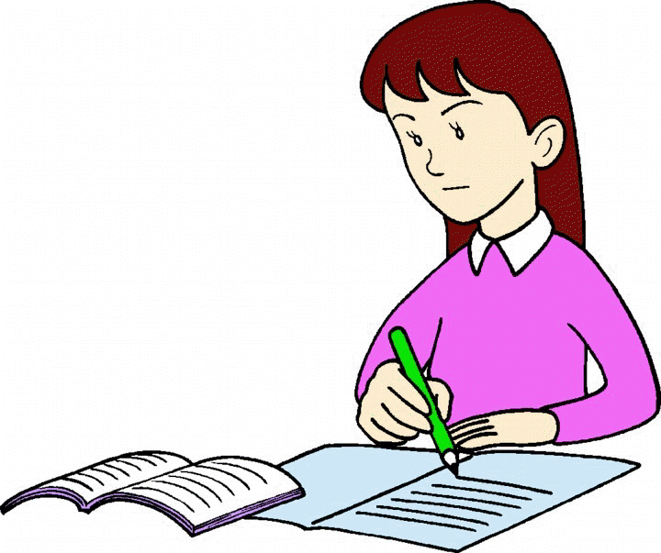
Signs of writing disability
Poor or illegible handwriting
Paragraphs and stories that are missing elements
Excessive spelling errors
Excessive punctuation errors
Sentences that lack logical cohesion
Poorly formed numbers and letters
This Photo by Unknown Author is licensed under CC BY-NC

Slide 14
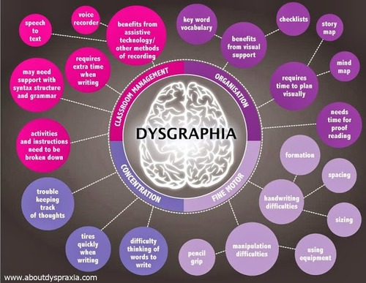
This Photo by Unknown Author is licensed under CC BY-SA

Slide 15
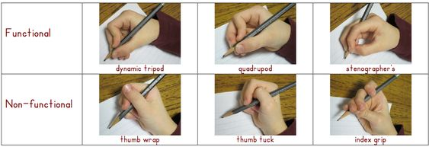
Pencils grip

Slide 16
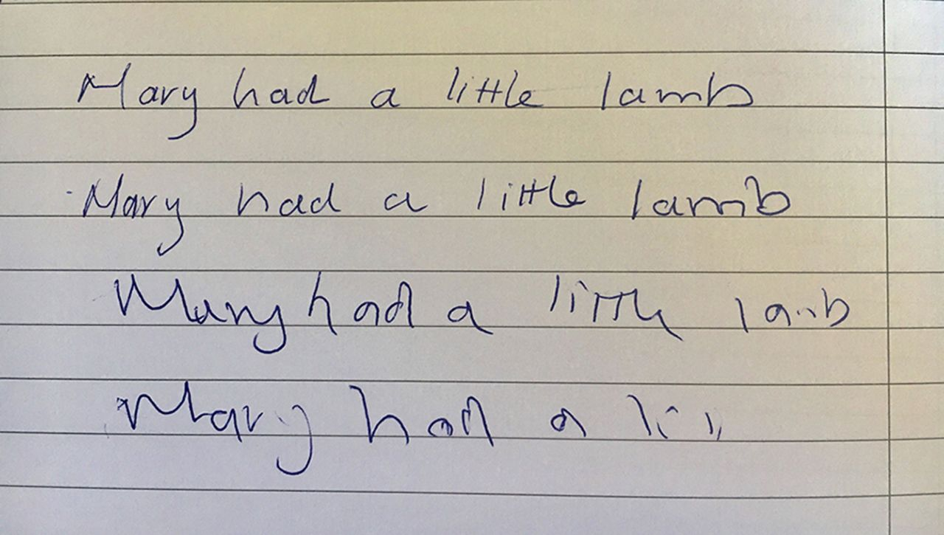
Dysgraphia examples

Slide 17
Math disabilities
Math Word Problems
Math Calculation

Slide 18
Math word problems
The child exhibits difficulty with some or most of the processes involved in solving math word problems such as:
Reading the word problem
Understanding the language or meaning of the sentences and what the problem is asking
Sorting out important information from extraneous information that is not essential for solving the problem
Implementing a plan for solving the problem
Working through multiple steps in more advanced word problems
Knowing the correct calculations to use to solve problems
Source:https://www.greatschools.org/gk/articles/math-disability-in-children-an-overview/
This Photo by Unknown Author is licensed under CC BY-ND

Slide 19
Math calculations
when there is a disconnect in learning the basic skills in early math instruction
Struggle in basic math facts
Struggle with some or most of the following skills…………….
Identifying signs and their meaning (e.g., +, -, x, <, =, >, %, ?) Automatically remembering answers to basic arithmetic facts (combinations) such as 3 + 4 =?, 9 x 9 = ?, 15 – 8 = ?.
Understanding the commutative property (e.g., 3 + 4 = 7 and 4 + 3 = 7)
Solving multi-digit calculations that require “borrowing” (subtraction) and “carrying” (addition)
Misaligning numbers when copying problems from a chalkboard or textbook
Ignoring decimal points that appear in math problems
Forgetting the steps involved in solving various calculations
Source:https://www.greatschools.org/gk/articles/math-disability-in-children-an-overview/

Slide 20
https://www.youtube.com/watch?v=KdxEAt91D7k

Slide 21
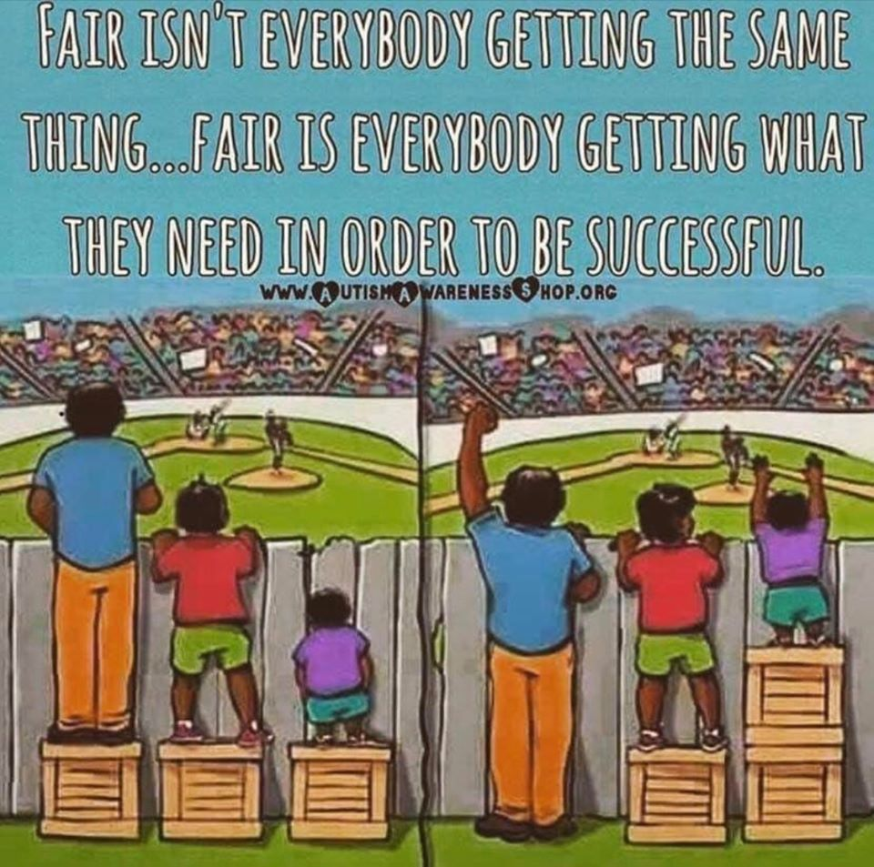
What are Accommodations?
supports that help even the playing field for students with disabilities.
Source: Interaction institute for social change
https://interactioninstitute.org/illustrating-equality-vs-equity/

Slide 22
Types of reading accommodations
Oral administration of test and/or assignments
Check for understanding
Extra time (for reading)
Individual or Small group administration of test
Clarification of vocabulary
Dictionary
Exempt from reading in front of peers
Preview of text before assigned
This Photo by Unknown Author is licensed under CC BY-SA

Slide 23
Writing accommodations
Extra time (for thinking and planning)
Editing sheet
Graphic organizer
Small group administration for tests
Allow for verbal responses
use of a tape recorder to record responses
Type responses or assignments on computer
Dictionary
No penalty for spelling on rough drafts

Slide 24
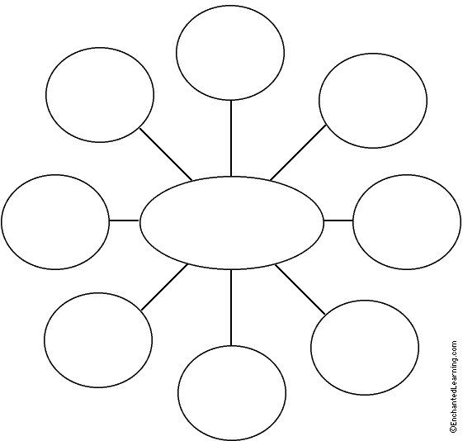
Graphic Organizer
This Photo by Unknown Author is licensed under CC BY

Slide 25
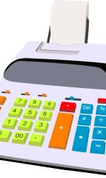
Accommodations for math
Calculator
Small group administration of test
Check for understanding
Multiplication chart
Frequent feed back
Chunk assignments/check ins ( do 5 and check)
Math manipulatives
This Photo by Unknown Author is licensed under CC BY-ND

Slide 26
This Photo by Unknown Author is licensed under CC BY-SA-NC

Slide 27
What is inclusion
when students with disabilities are included in classes and learning environments with “typical” peers that are their age and/or grade level.
Inclusion classes may have a second teacher or paraprofessional in the class room to assist student with disabilities (teacher often helps all students)
*Paraprofessional-Someone who has some college credit, but hasn’t graduated with a degree.
This Photo by Unknown Author is licensed under CC BY

Slide 28
Questions??
This Photo by Unknown Author is licensed under CC BY-NC

