Slide 1
Weight Lap Pads
Weighted Lap Pads

Slide 2
Why Weighted Lap Pads
Weighted lap pads help with deep touch pressure therapy (DTP). By giving a calming, organizing effect on children and adults when used.
https://www.sensacalm.com/blogs/news/5-ways-a-weighted-lap-pad-can-help-your-child-or-you Source

Slide 3
Who benefits
Students with………….
Attentions Deficit Disorder
Autism
Sensory Processing Disorder
Mood Disorders (depression, anxiety, PTSD)

Slide 4
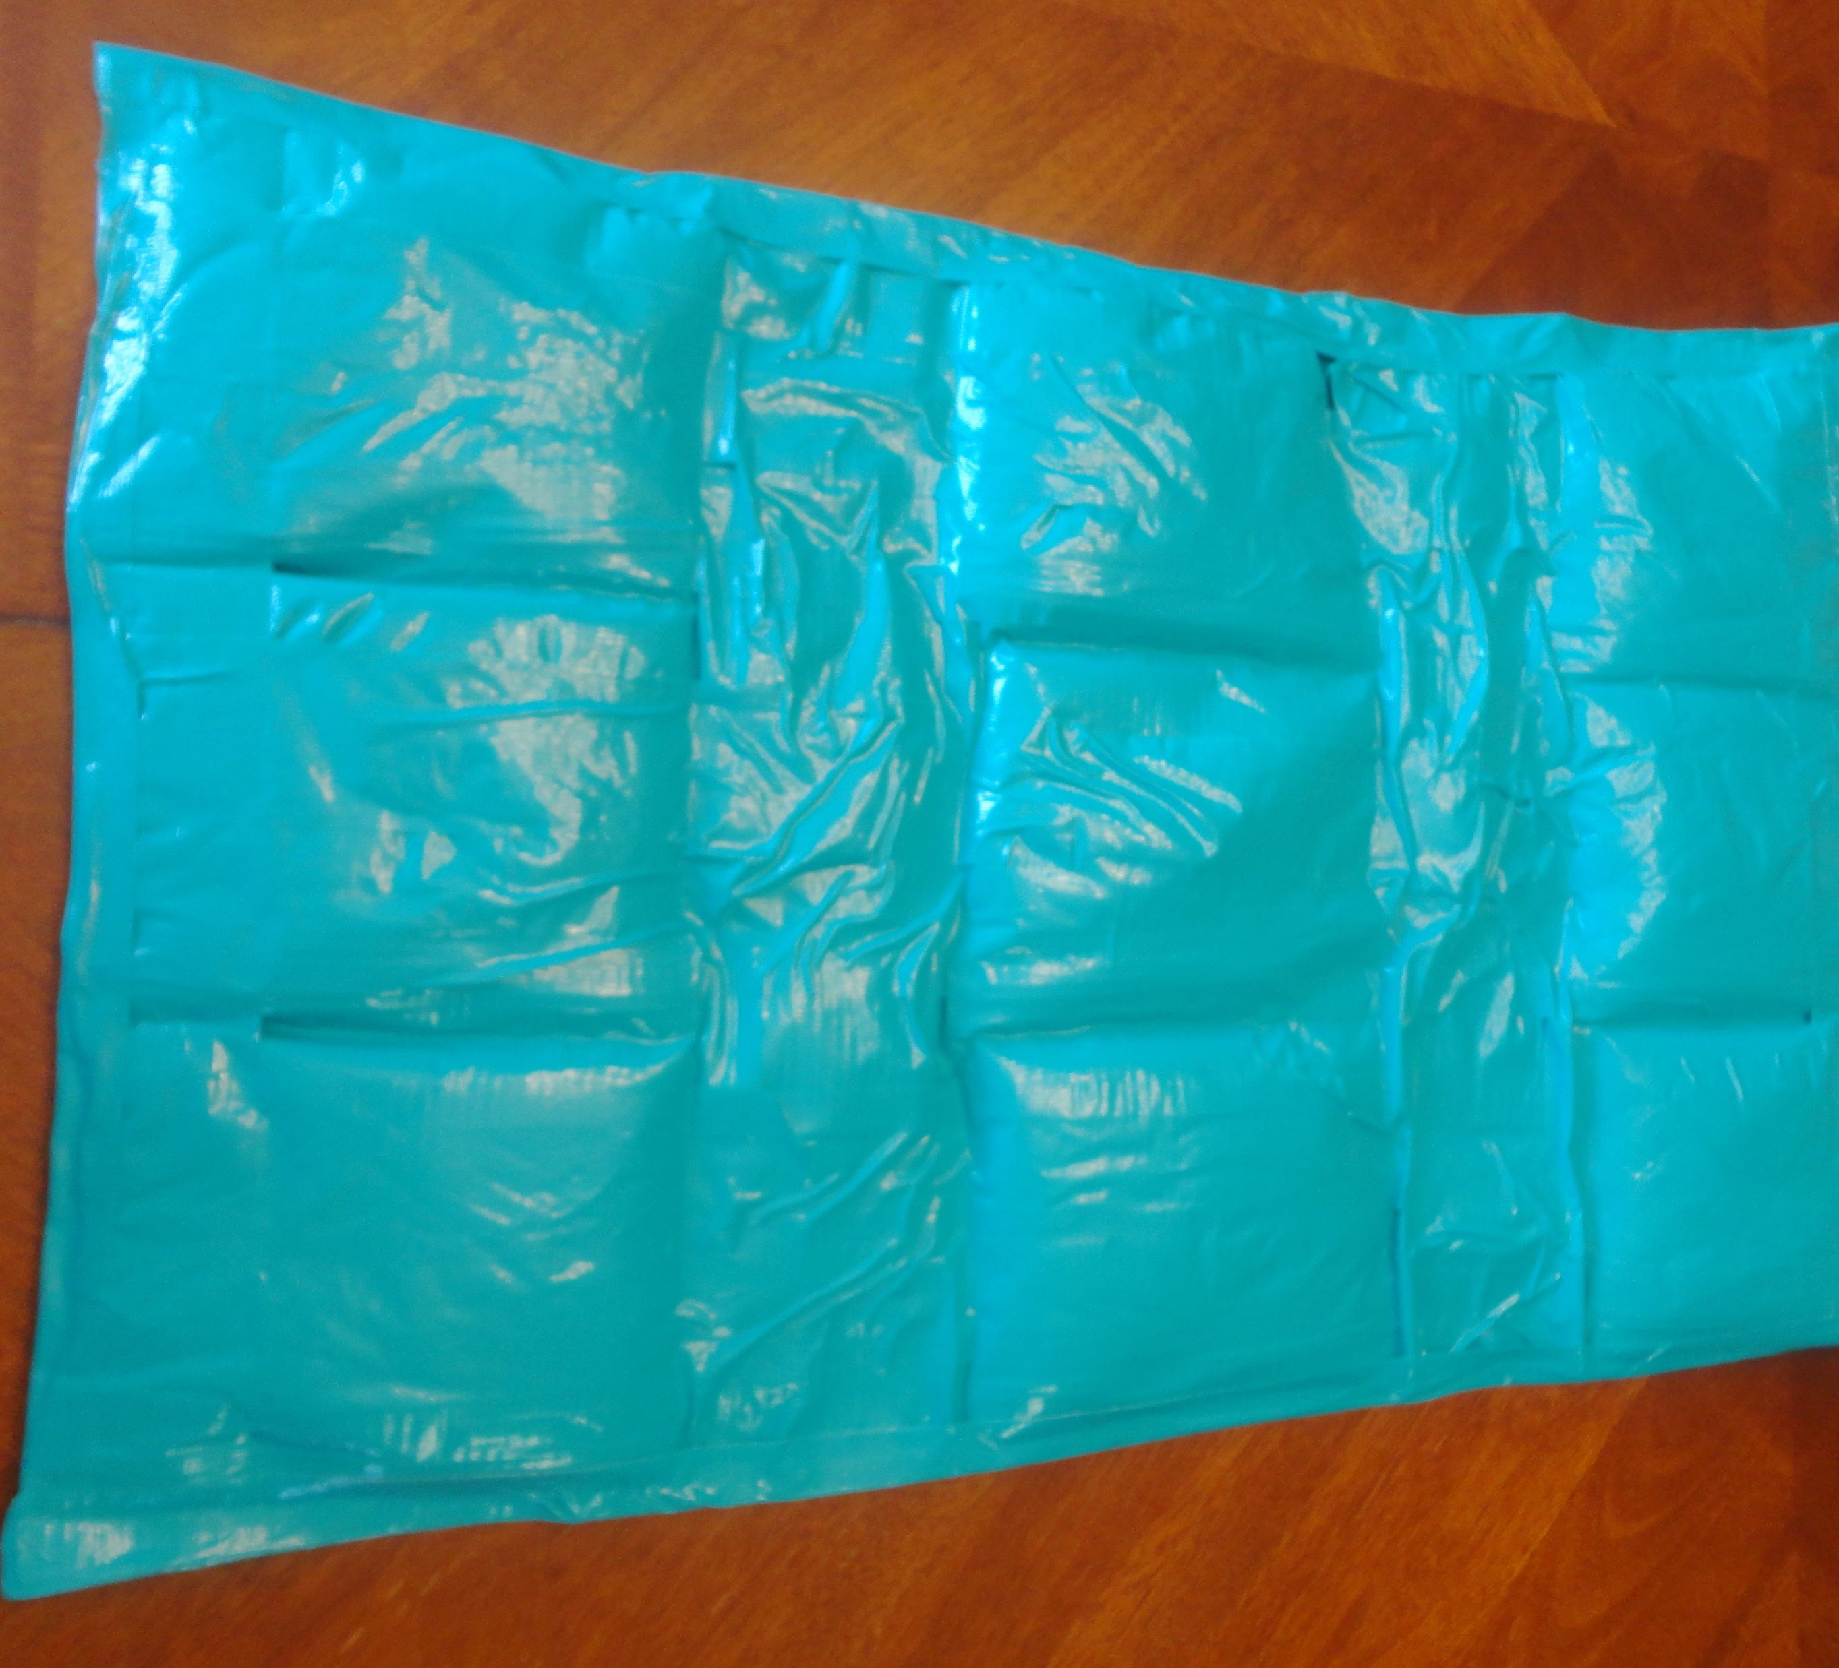
Benefits of lap pads
Improves focus
Reduces Anxiety
Calms melt downs
Makes transitions easier

Slide 5
Where can lap pads be used….
Lap pads can be used
In the classroom
At home
At restaurants
All most anywhere!

Slide 6
Materials needed
Sand
Sandwich bags
Duck tape
Scale (To weigh Sand)
Scissors (If needed to rip tape)

Slide 7
http://otinpublicschools.blogspot.com/2014/12/rice-duct-tape-baggies-thats-all-you.html

Slide 8
http://otinpublicschools.blogspot.com/2014/12/rice-duct-tape-baggies-thats-all-you.html

Slide 9
http://otinpublicschools.blogspot.com/2014/12/rice-duct-tape-baggies-thats-all-you.html

Slide 10
http://otinpublicschools.blogspot.com/2014/12/rice-duct-tape-baggies-thats-all-you.html

Slide 11
http://otinpublicschools.blogspot.com/2014/12/rice-duct-tape-baggies-thats-all-you.html

Slide 12
http://otinpublicschools.blogspot.com/2014/12/rice-duct-tape-baggies-thats-all-you.html

Slide 13
http://otinpublicschools.blogspot.com/2014/12/rice-duct-tape-baggies-thats-all-you.html

