Slide 1
Strategies for Behavior
To name a few….
Where to find things…
Making supports

Slide 2
Changing behavior
Why change?
How was the behavior acquired? What reinforced it?
What new behavior is hoped for?
What’s the plan?
What do I need to make the change?
How long will it take?

Slide 3
What function does the behavior provide?
Escape: If I do this then I don’t have to do that.
Attention seeking: Look at me!
Negative attention seeking: Teacher always yells at me. (Maybe I’ll get sent out and can escape!)
Feels good! Self stimulation.
Sensory seeking (taste, feel, sound, drone out sound, smell, pressure)
Escape pain: Noise, too much stimulation….

Slide 4
What reinforces the behavior?
Life-long habit that gets child what they want. “If I do/say this then someone will give me what I want to stop doing it.”
Self-stimulation helps child escape negative stimulation. ( I will spin this toy to block out the overpowering sensory environment.)
Behavior causes someone to remove a difficult or unwanted task.
My teeth hurt so biting puts pressure on gums and relieves pain/I get someone to pay attention to me. They rub my back to calm me down, that feels good.

Slide 5
ABC Chart
Antecedent: What happened before behavior occurred?
Behavior: What did child do? What did behavior look like?
Consequence: What was the environmental reaction? Class, teacher……

Slide 6
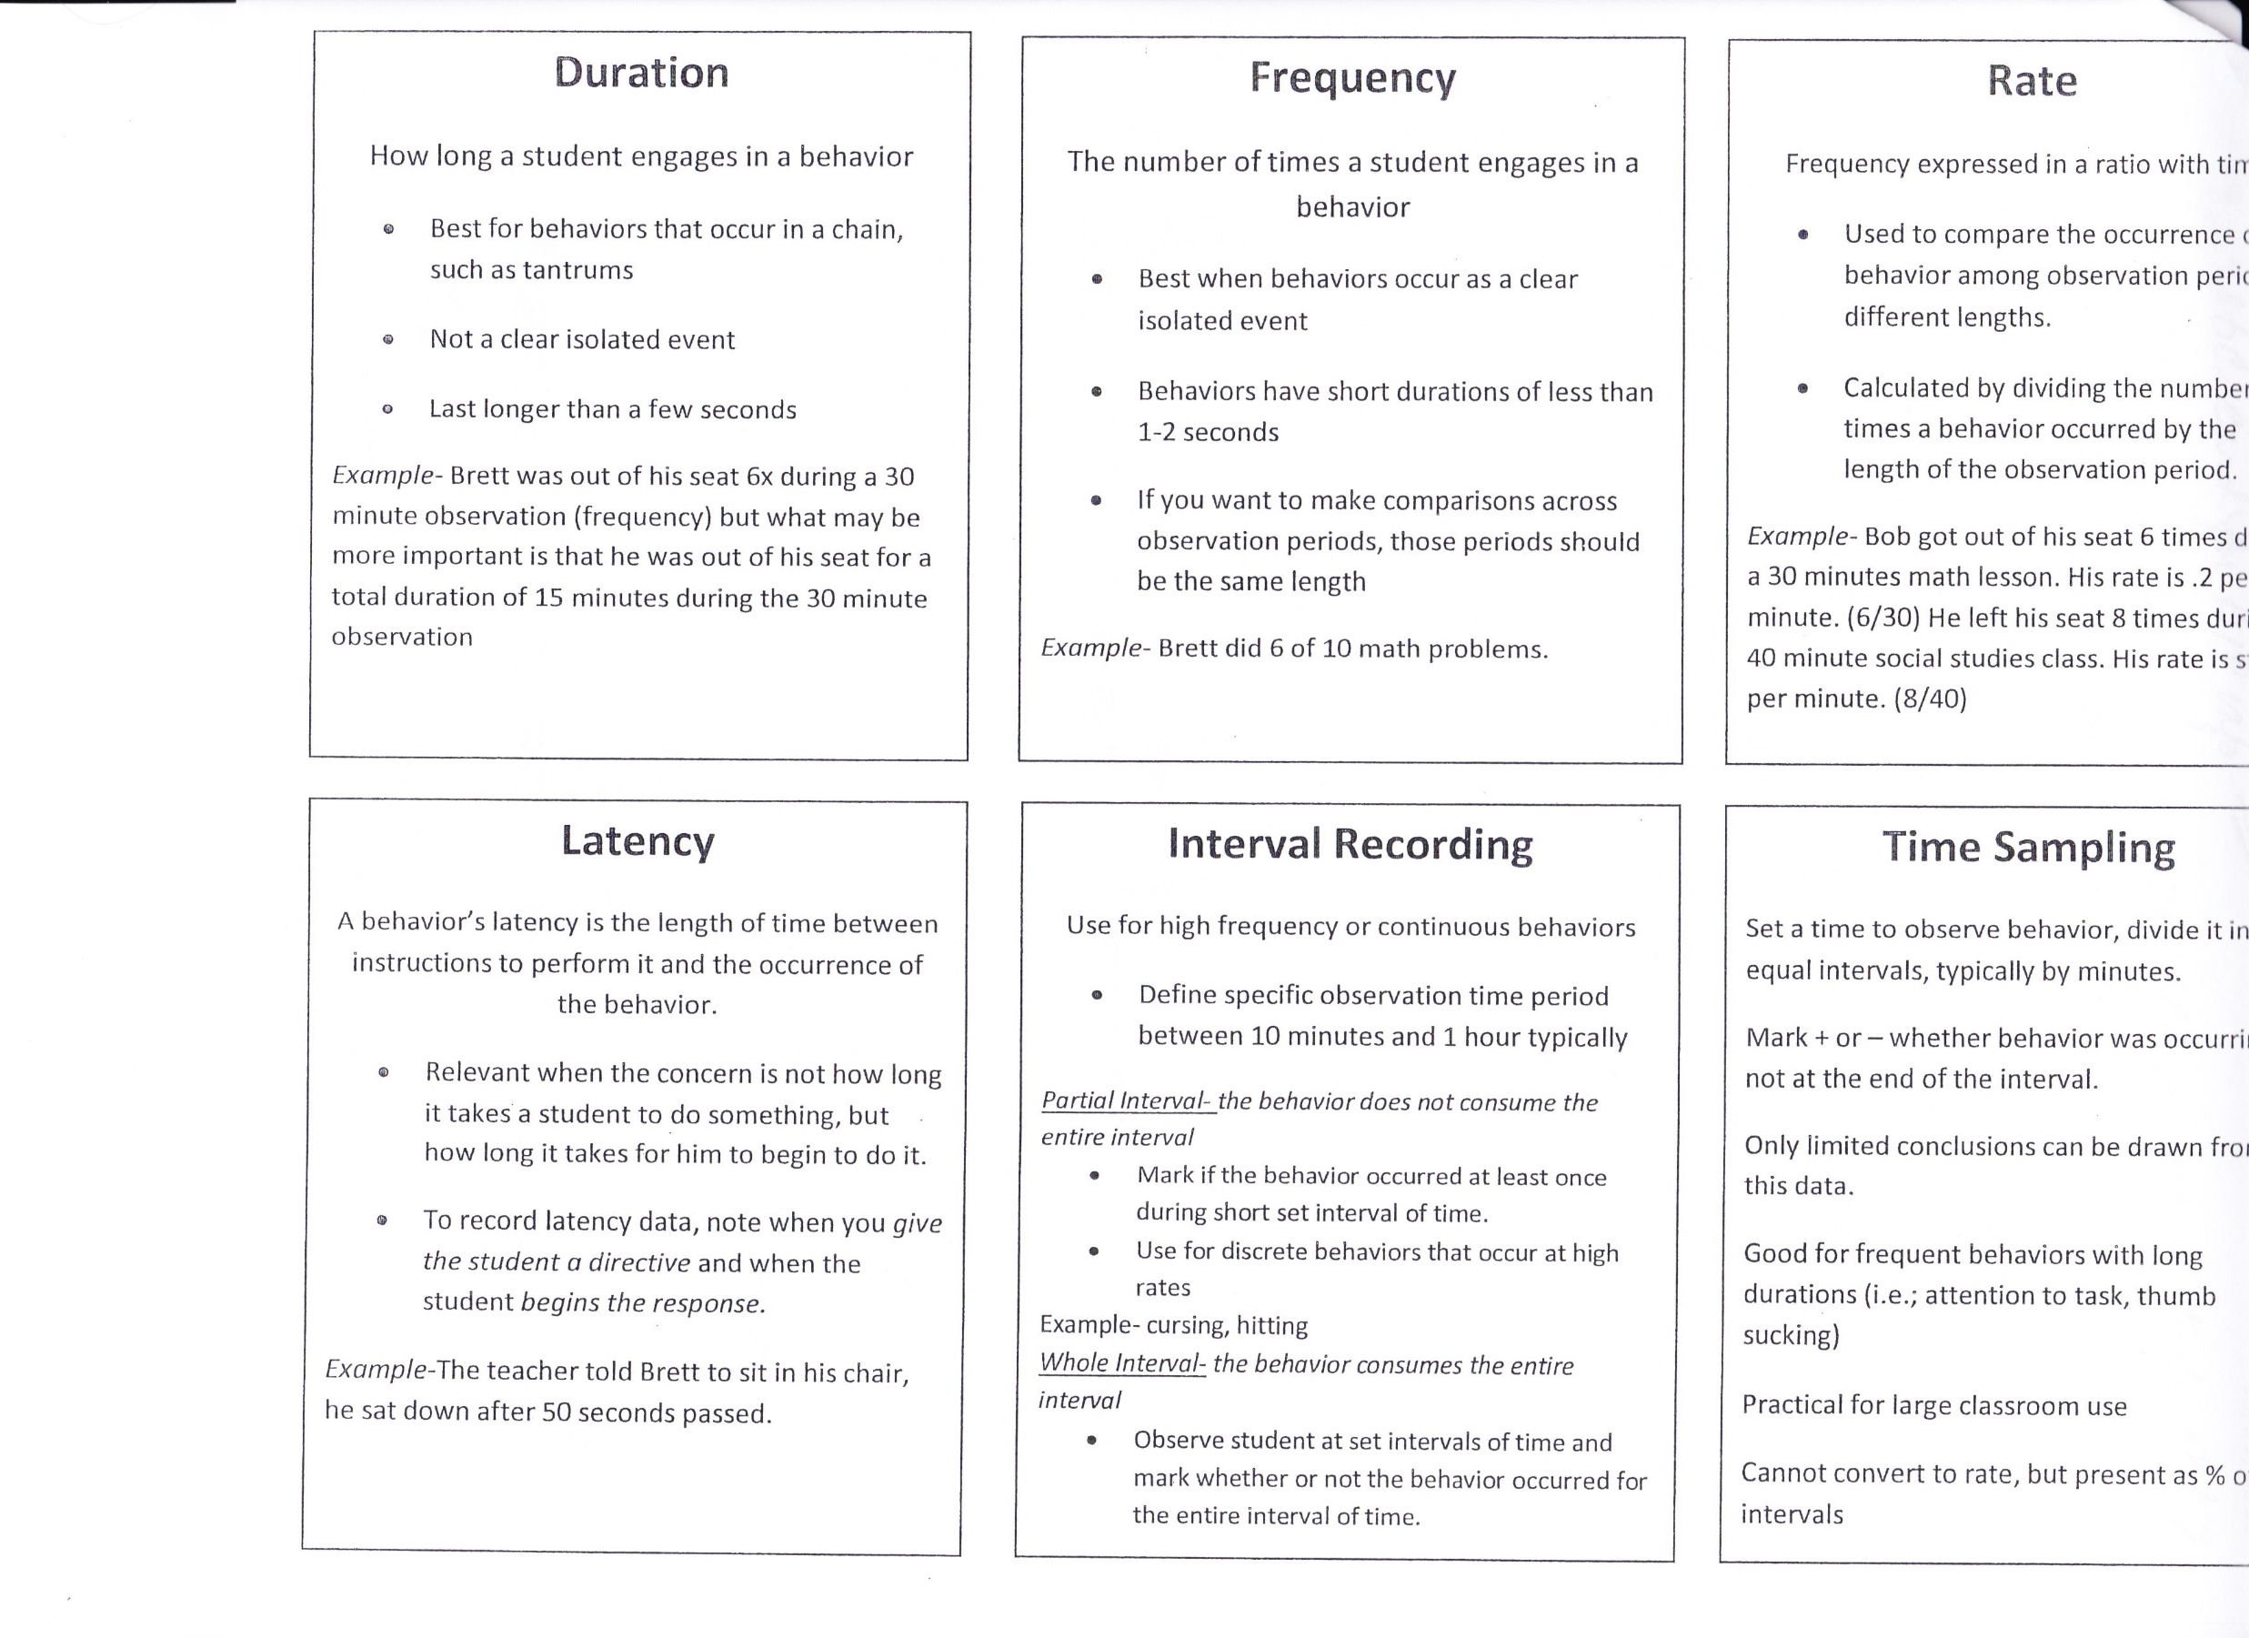

Slide 7
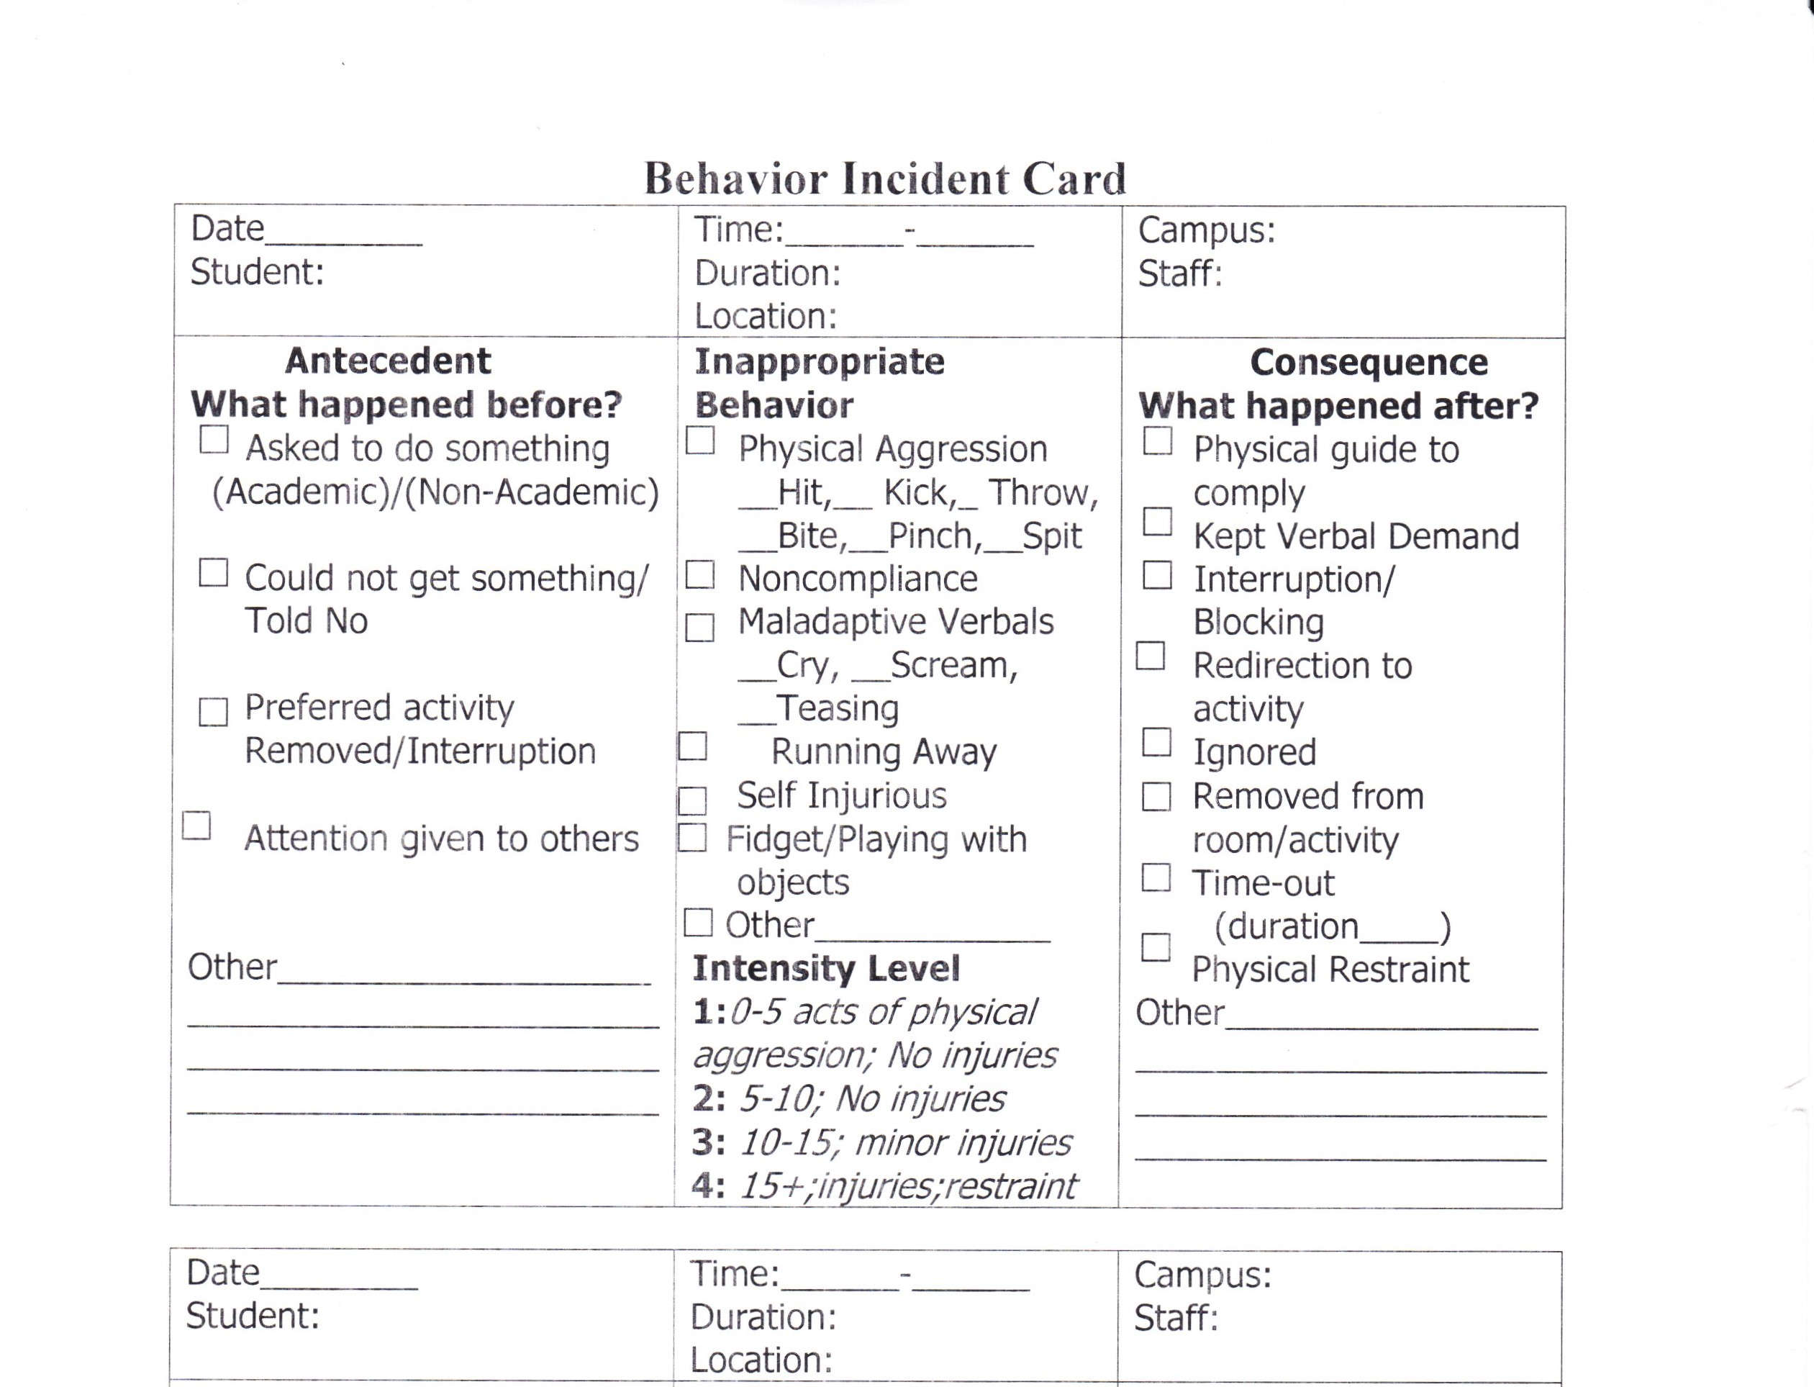

Slide 8
Behavior Principles
All Behavior is learned
Behavior serves a function
Environment impacts behavior
Skill deficits impact problem behavior
Team approach is critical
The student-teacher relationship matters!!!

Slide 9
Strategies to help encourage cooperative behaviors
Identify strong reinforcers (more than one)! The value of reinforcer must outweigh function of the behavior.
Pair self with child’s reinforcers. Until child is approaching you to receive or request reinforcer, pair your voice with reinforcer.
Don’t interrupt child’s interaction with reinforcer to place a demand. Go to the child’s reinforcer and reinforcing environment. DO NOT reward with “Go Play”
Arrange for teaching table to be place child goes to for reinforcer. Don’t remove reinforcer but eventually make it “First this .. Then this…”
Begin making very easy that result in immediate reinforcement. (Sit down, something child can and will do.)

Slide 10
Behavior Intervention Plan
What does desired behavior look like?
What steps needed to change behavior? How will the antecedent or environment be modified to change the outcome or avoid the behavior?
What consequences will occur if undesired behavior occurs? Or if desired behavior occurs?

Slide 11
Effective teaching procedures
Positive reinforcers that will compete with reinforcers child has learned for interfering behaviors.
Mix and vary tasks asked of child.
Reduce chance of error. When difficult task presented the value of escape will increase so try errorless teaching, such as giving the answer.
Intersperse hard and easy tasks.
Be prepared with tasks so child can be reinforced and successful.
Reinforce positive outcomes!!!

Slide 12
Getting rid of an undesired behavior
Lots of trials needed to change a behavior. Child with autism does not have neurotypical brain and may require many strategies to find something effective and then lots of reinforcement!!
Substitute an undesirable behavior with something more appropriate.
Provide brief opportunities for sensory gratification such as spinning, running, jumping, rocking in a chair, sensory toy… then return to other reinforcer with demands
Make and follow a plan and change it if it is not working!

Slide 13
Accepting “No”
When child wants an undesired activity, say “No.” As you say no, bring a reinforcer or offer other activity by saying “but you can have If the child do this(reinforcer) instead.”
If the child does not engage in problem behavior, deliver the reinforcer. If the child does engage in activity, put reinforcer away and withdraw other offer and do not attend to behavior. If demand, given deliver command and carry on.
Practice sessions to reinforce learning “no”

Slide 14
Social Behavior Mapping Expected Versus Unexpected Behaviors
Social Thinking http://www.socialthinking.com Concept that behaviors are expected or unexpected depending on the situation not appropriate/inappropriate as in different situation different behaviors are acceptable/unacceptable.
Using the Social Thinking Map a person looks at various situations, predicts expected/unexpected outcomes, imagines how others feel, how self will feel, and positive/negative outcomes.

Slide 15
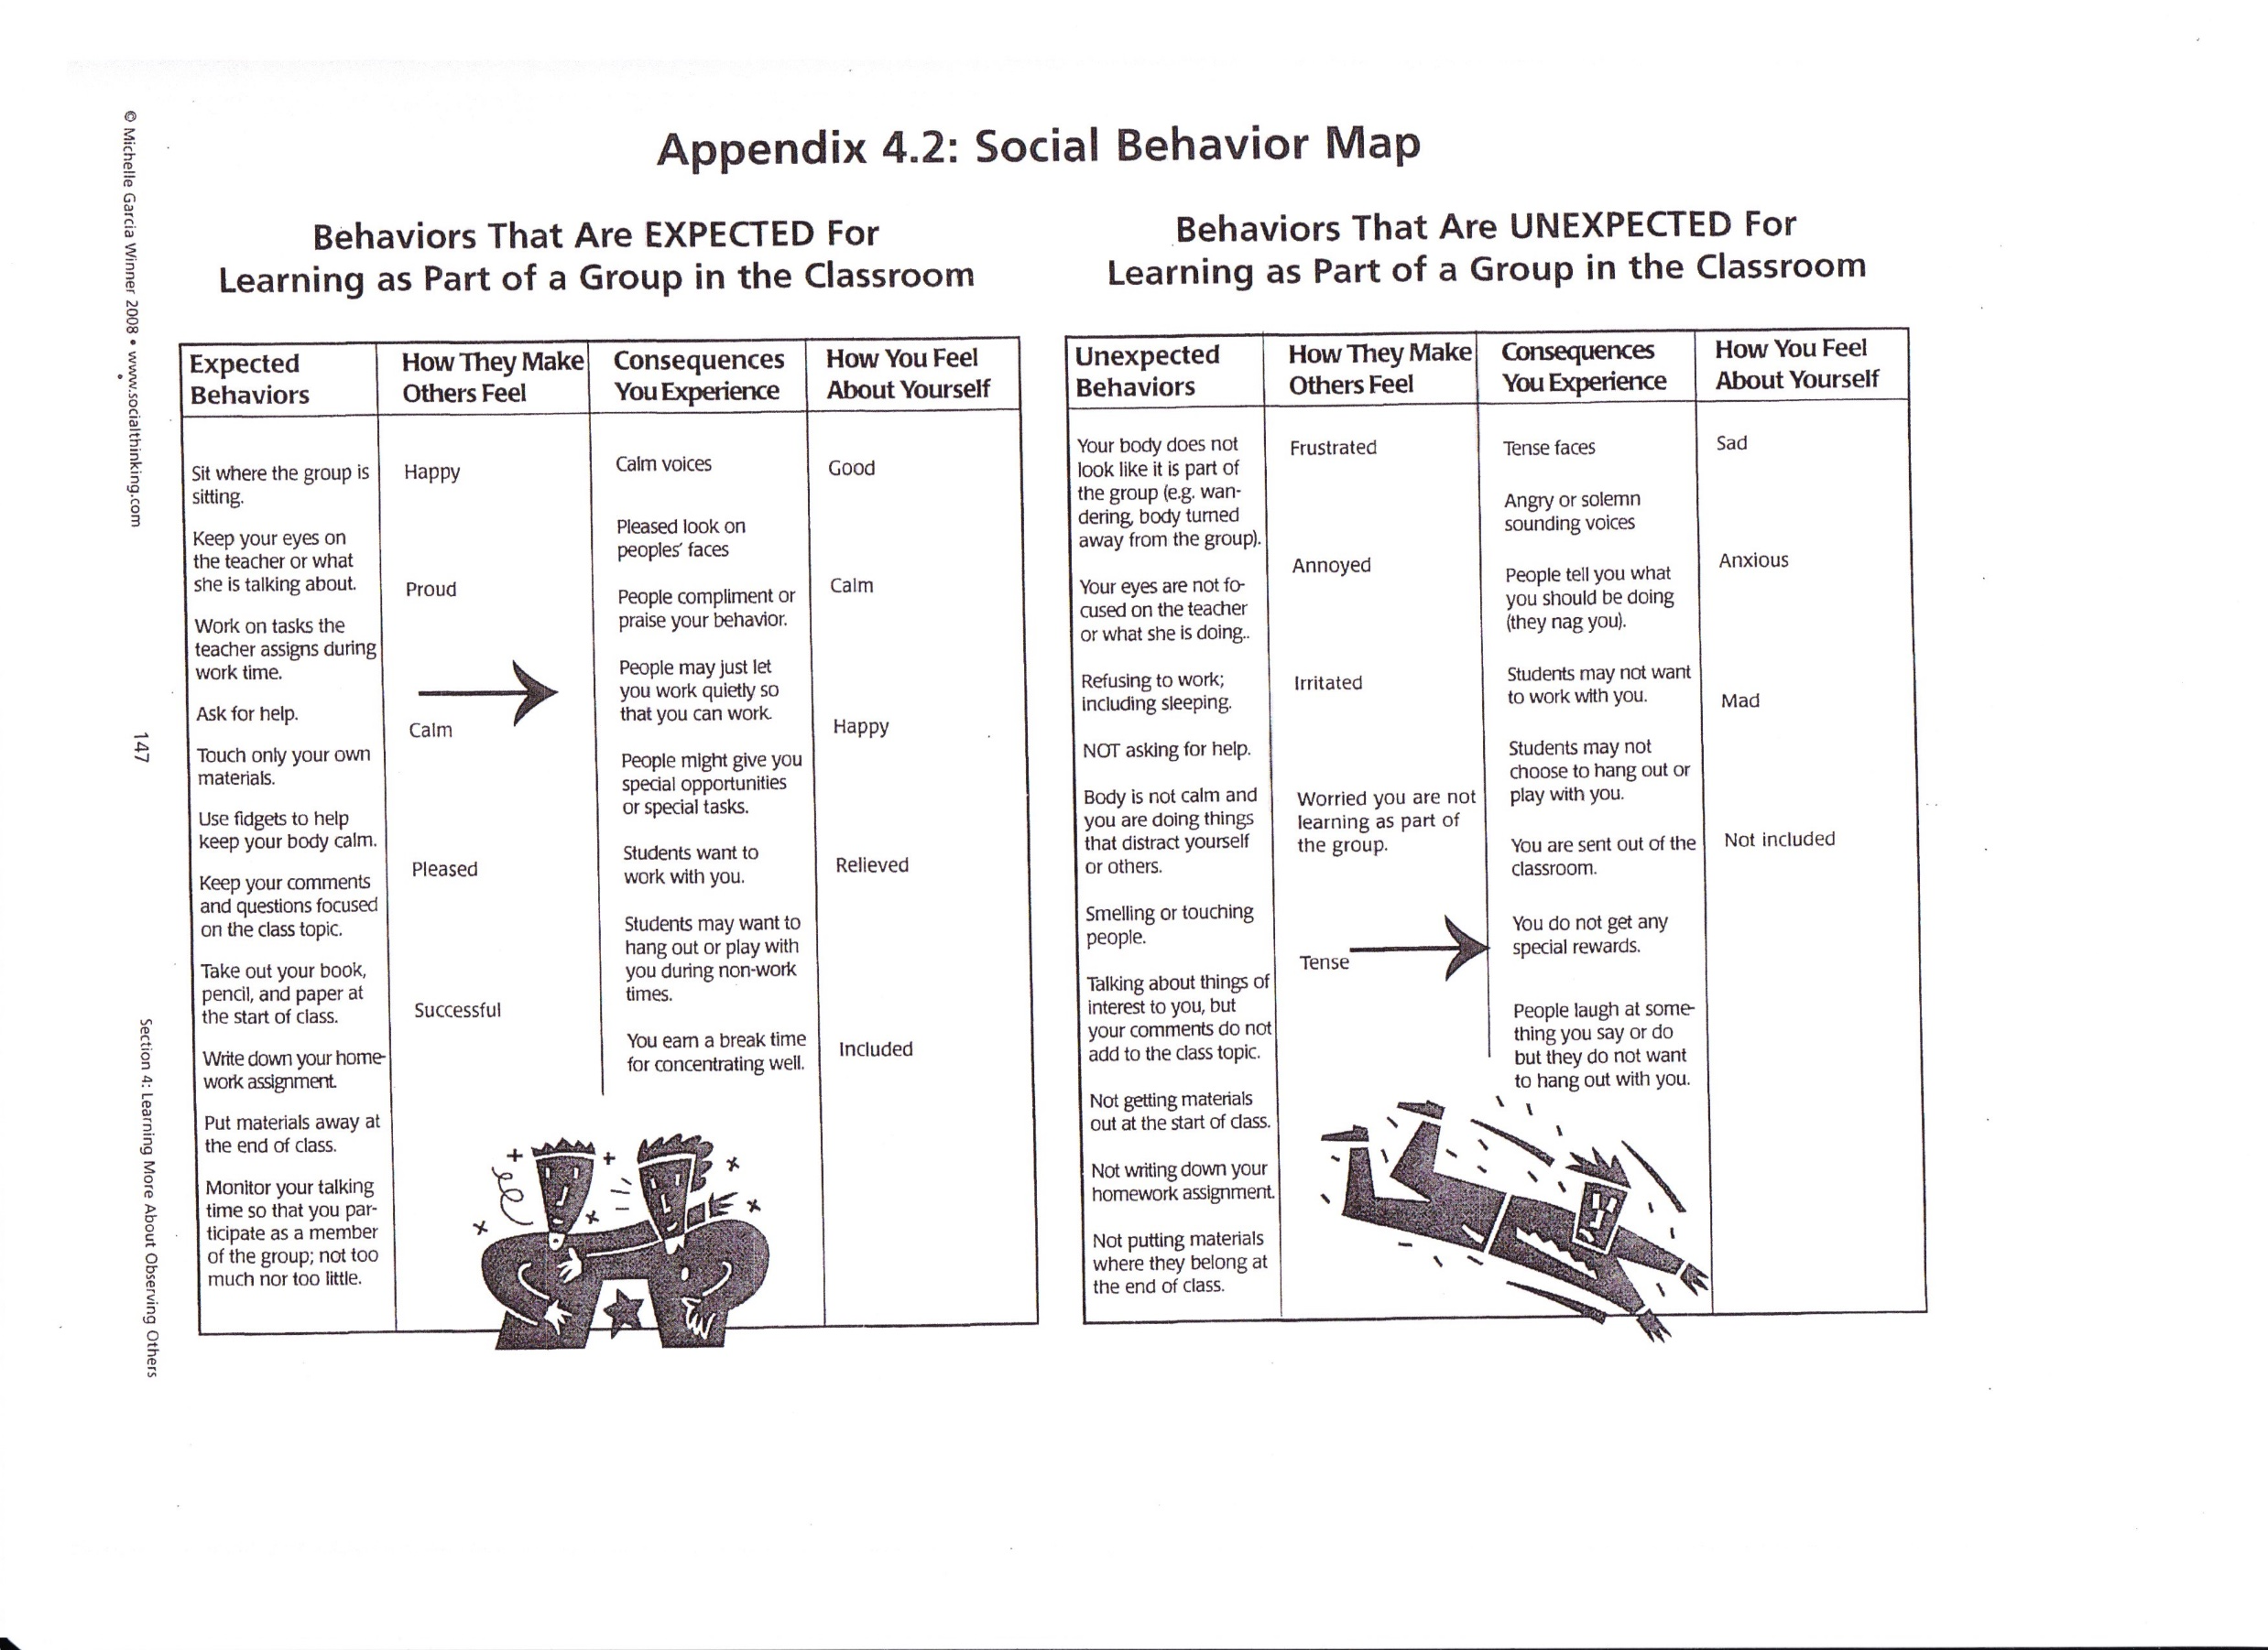

Slide 16
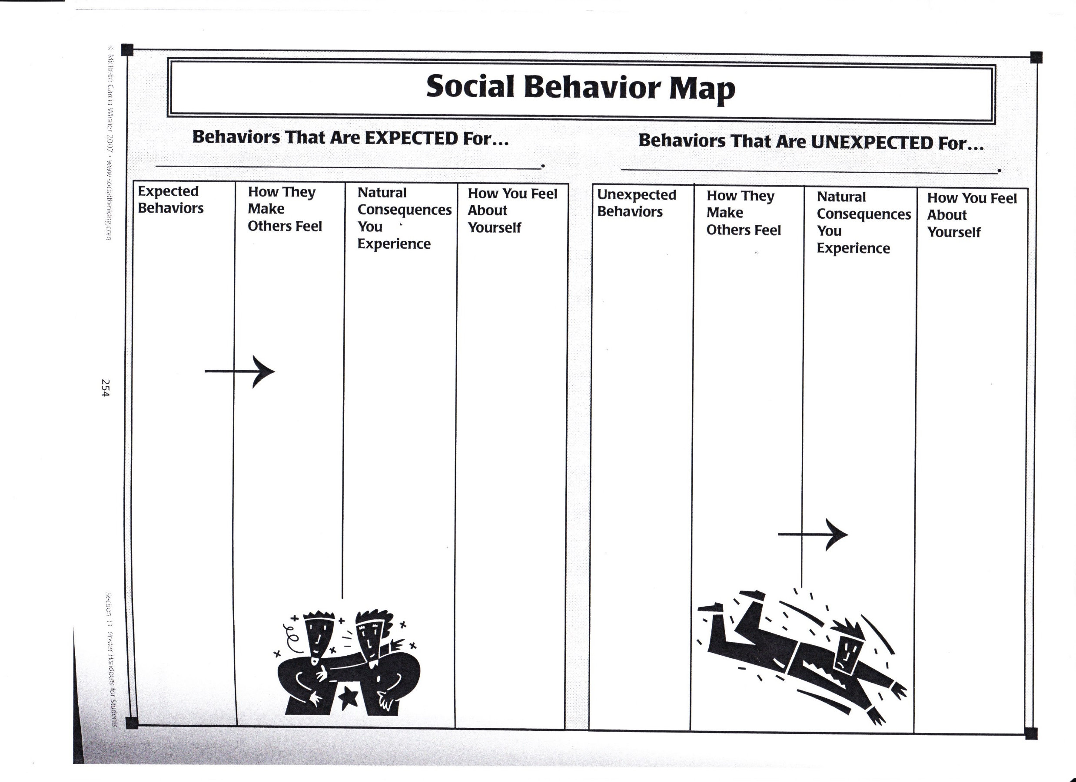

Slide 17
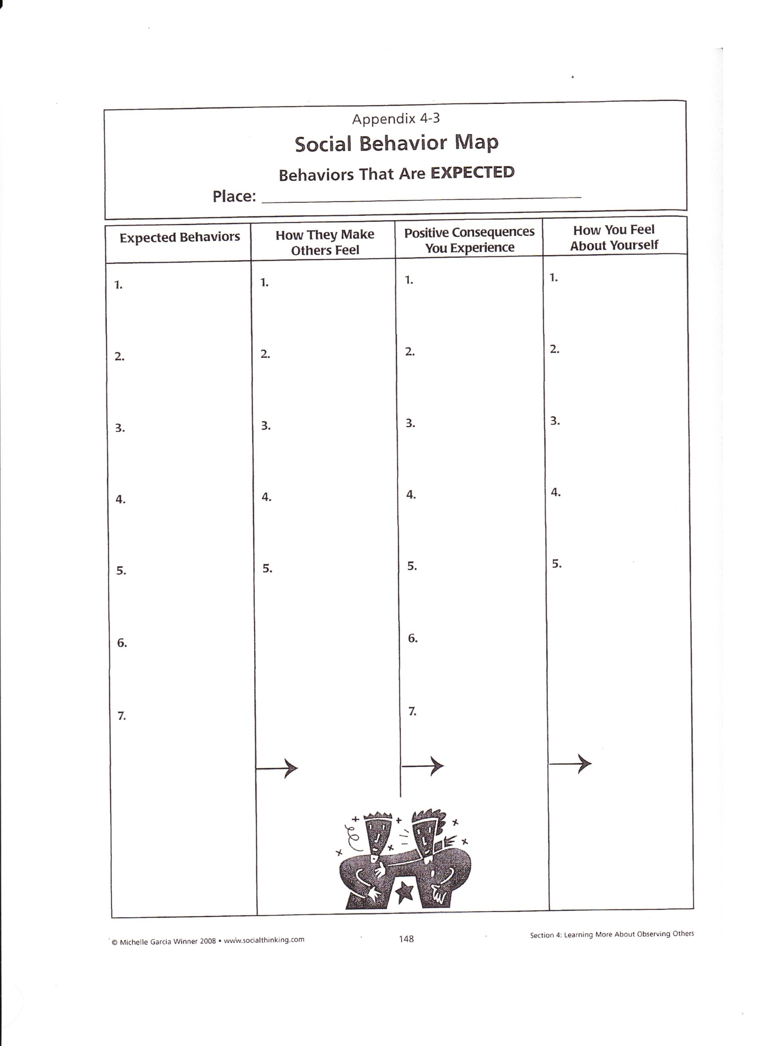
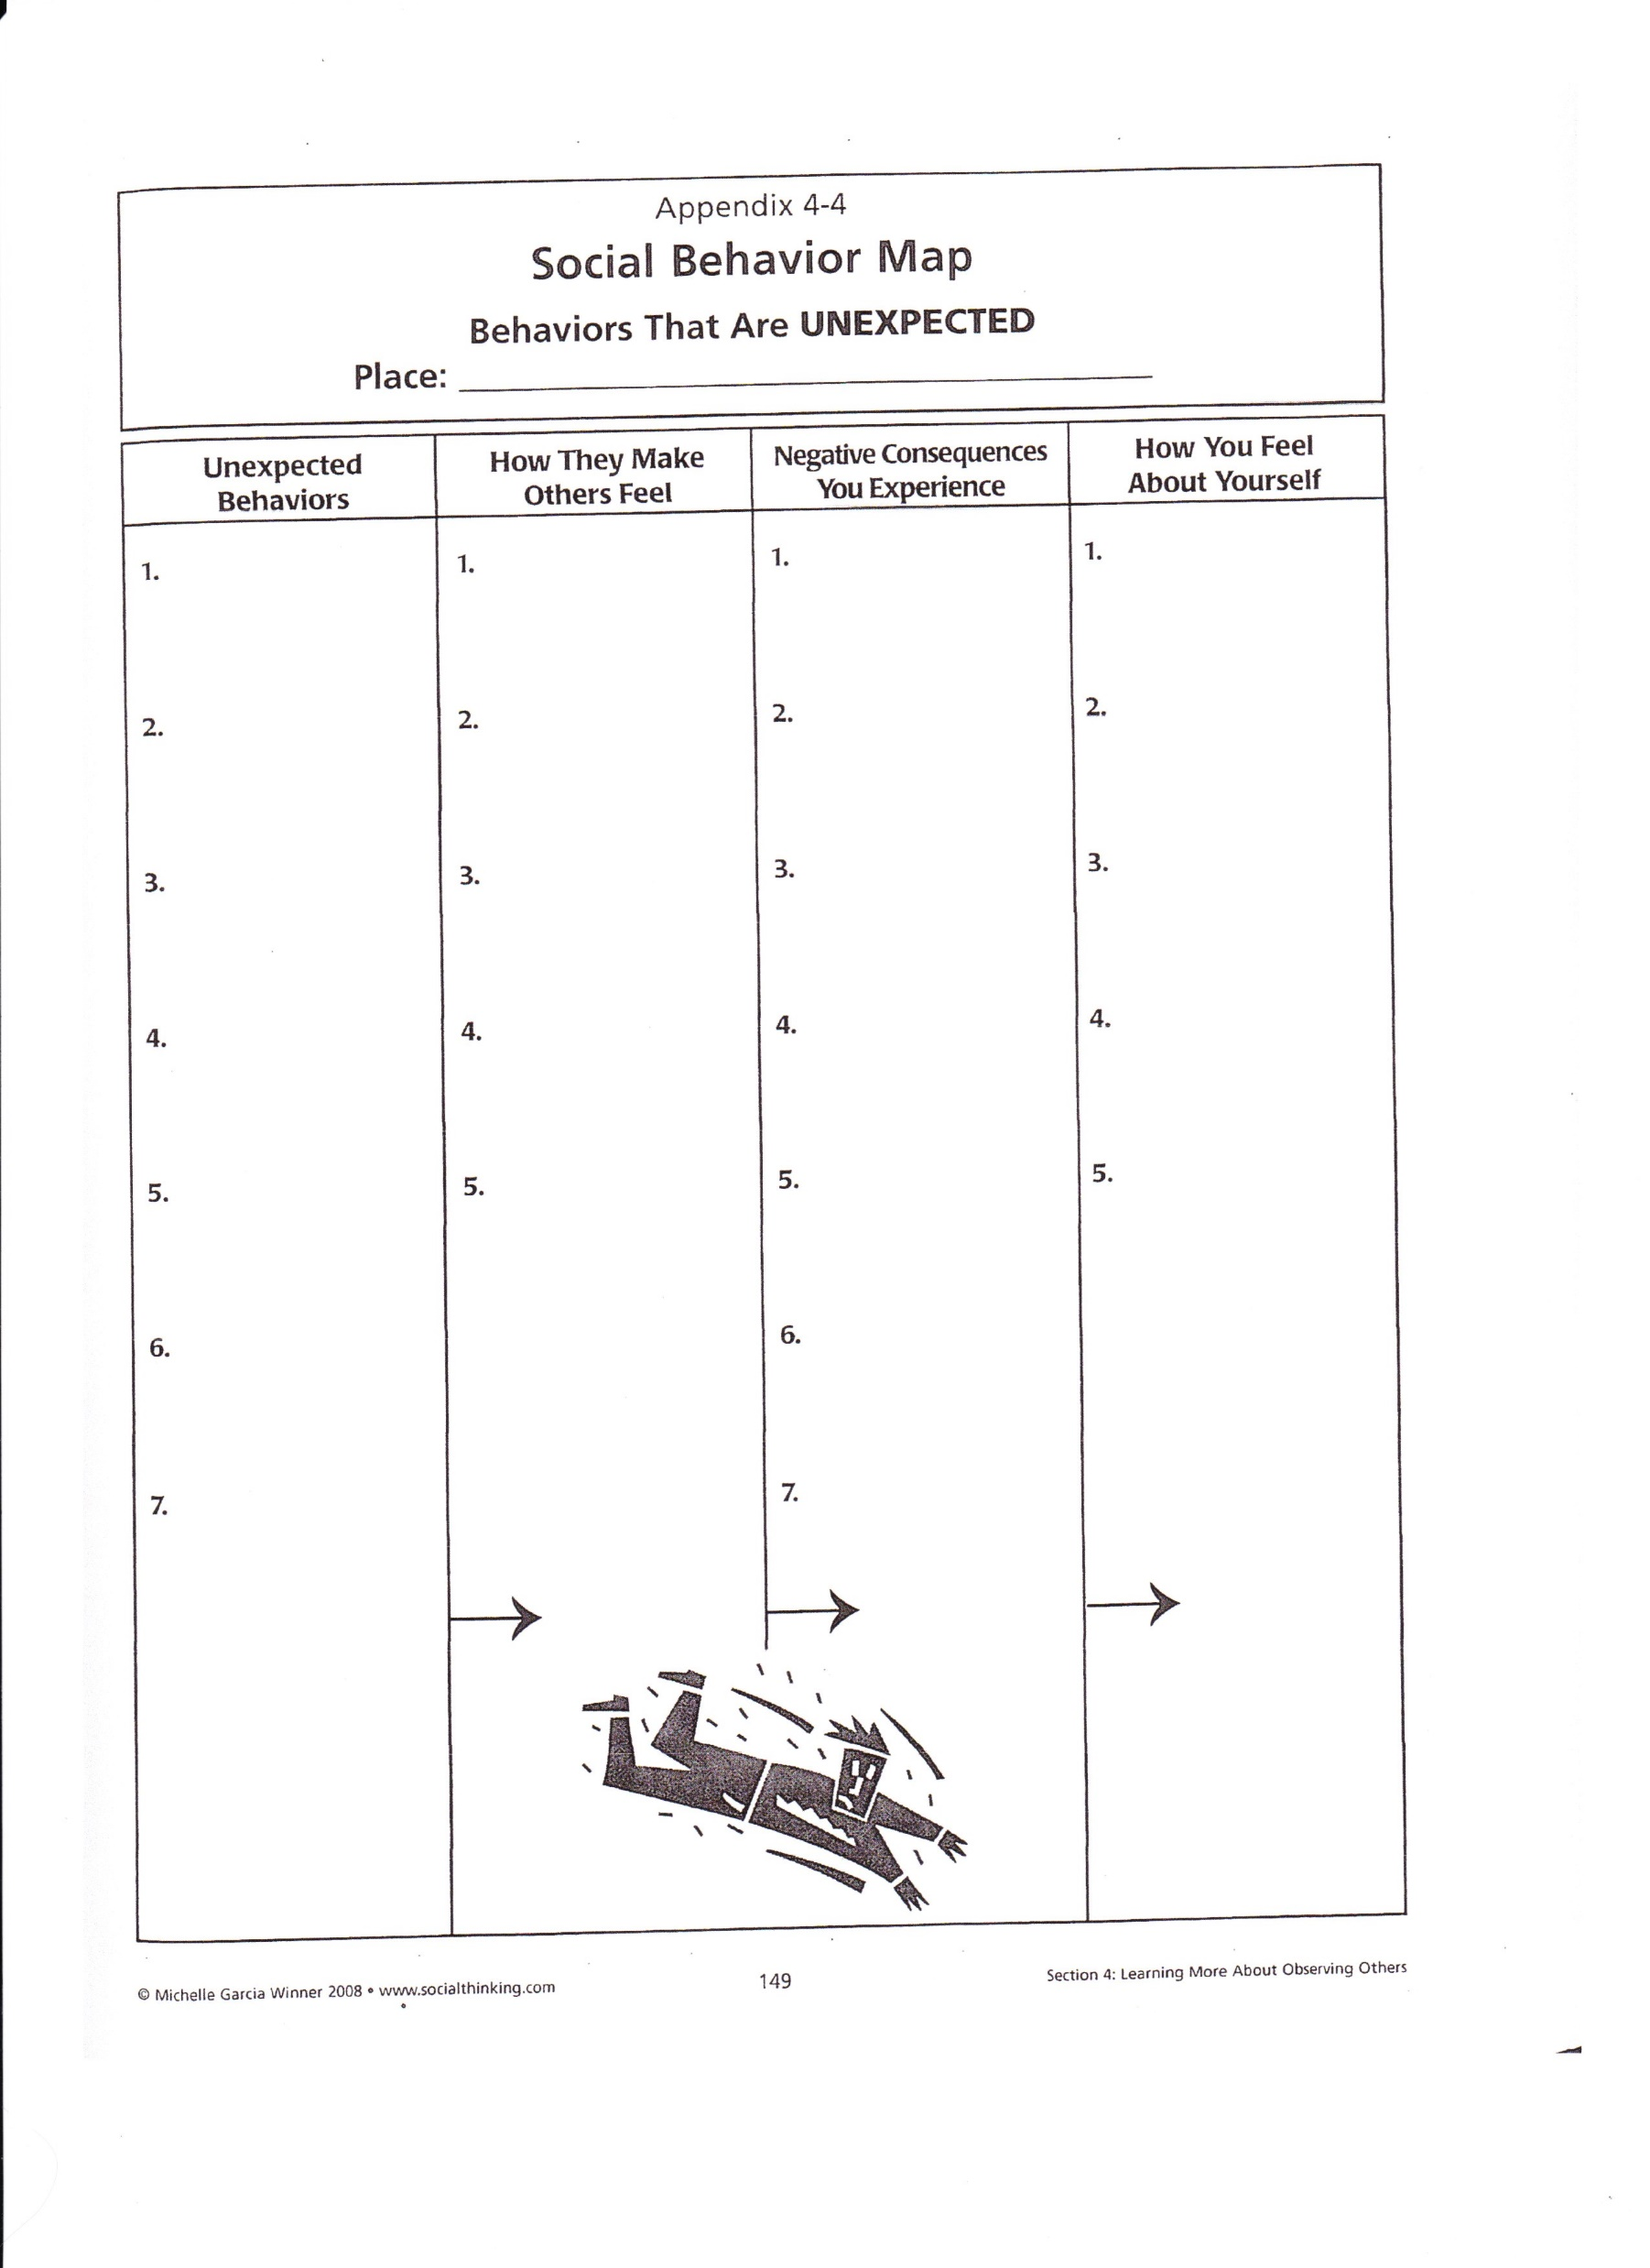

Slide 18
Looking at specific issues

Slide 19
Task Completion/Executive Function
Develop organizational skills by organizing the environment with visuals (Everything has a place!)
Teach child to see final product and plan backwards. https://chadd.org/wp-content/uploads/2018/06/ATTN_02_16_360_Thinking.pdf
3 2 1
Get Ready | DO | Done
What do I need? | What steps do I take? | What will it look like when I’m done?

Slide 20
Incredible Five Point Scale
The 5-point scale is exactly what it sounds like. A 5-point scale that is developed to help an individual understand and learn when emotions, voices, or whatever you are moderating is getting out of control. It can be developed by the teacher or parent or as a collaboration between the teacher / parent and the individual with autism (or other behavioral issues). It can be used successfully from kindergarten through high school. And many times I think it might be useful for some “typical” adults.
www.5pointscale.com

Slide 21
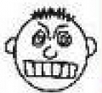
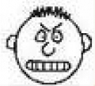
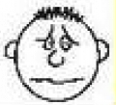
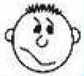
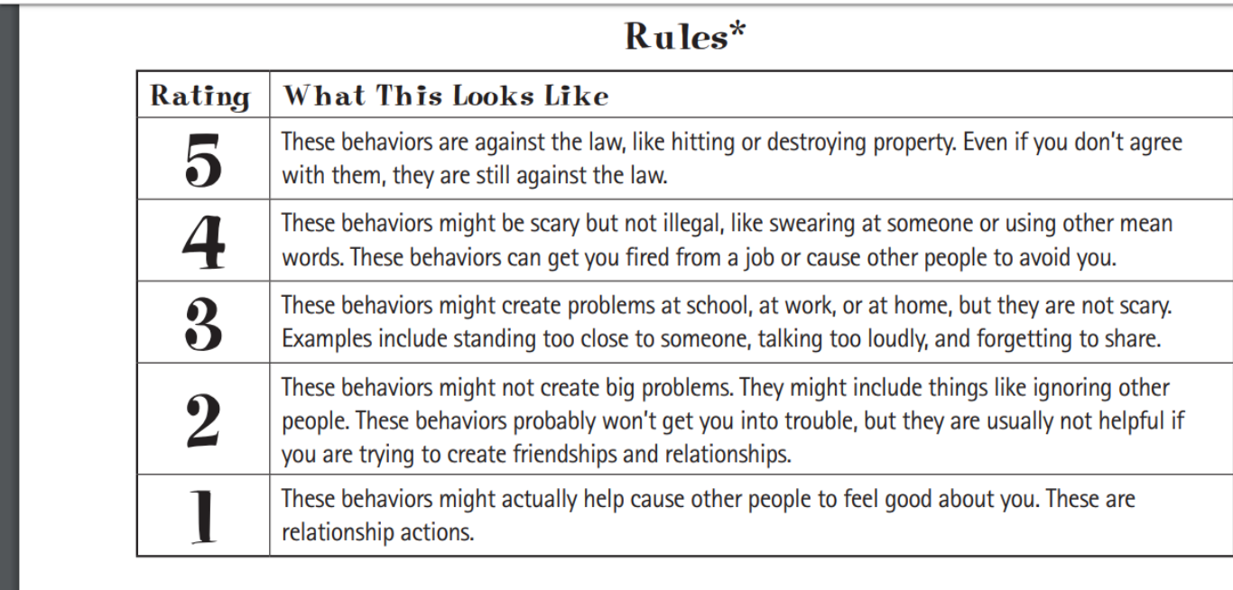

Slide 22
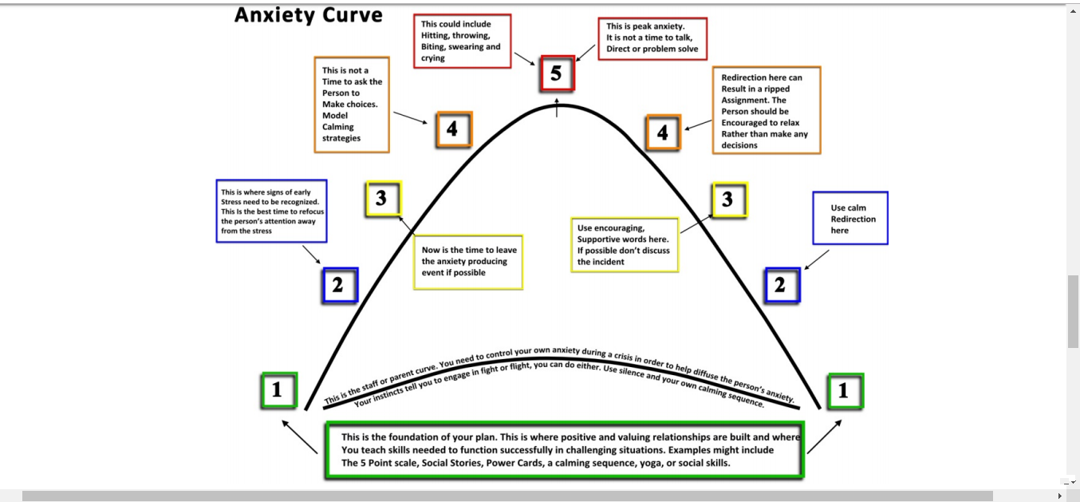

Slide 25
Vocabulary to use in the classroom
Adding to the fun/Taking away from the fun.
Expected/Unexpected rather than right/wrong, good bad, acceptable/unacceptable.
Following the plan/following the group plan.
Interruptaoaurus!
Keeping the brain/body in the group.
Perspective taking.
Plan B
Social Autopsy-talking about situation after its done, what happened and what to do next time.
Pocket it! Save that idea for later, either write it down or file in brain. Use a signal to nonverbally remind student to put it in the back of the brain.

Slide 26
The Six Sides of Breathing to get control!

Slide 27
Enticement Toolbox
Bubbles
Balloons
Wind up toys
Vehicle toys
Play food
Blocks
Balls- Koosh, squishy
Pretend play items: doll, plates, cup, bottle
Toys that do unexpected things

Slide 28
Social Stories
Identify social situation needing intervention
Define target behavior, take baseline data
Write a social narrative using language at child’s level. Consider using first person “I” language
Choose number of sentences per page according to functioning level
Use photos or hand drawn pictures or icons
Read social narrative to child and model desired behavior
Collect data
Review findings and adjust as needed
After behavior changed fade use of narrative

Slide 29
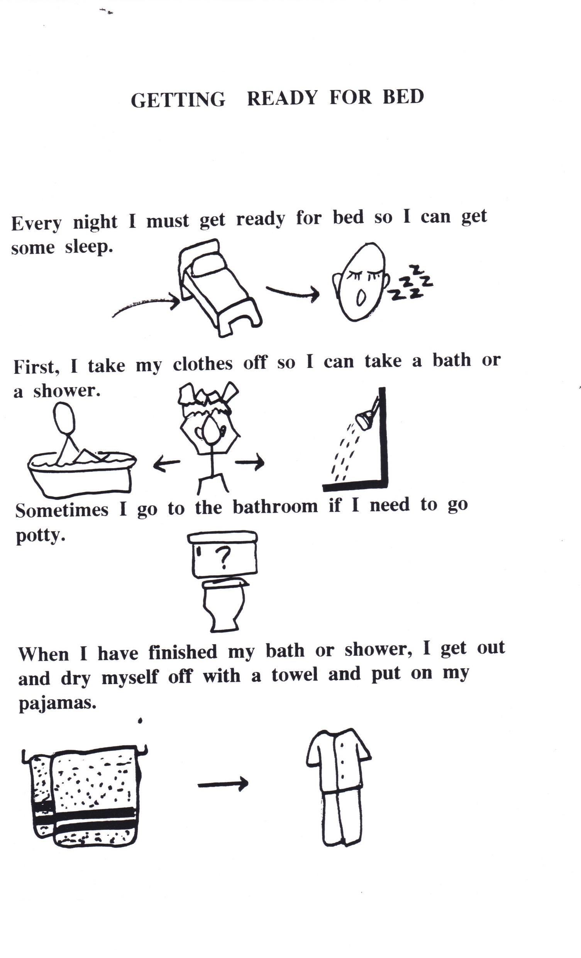
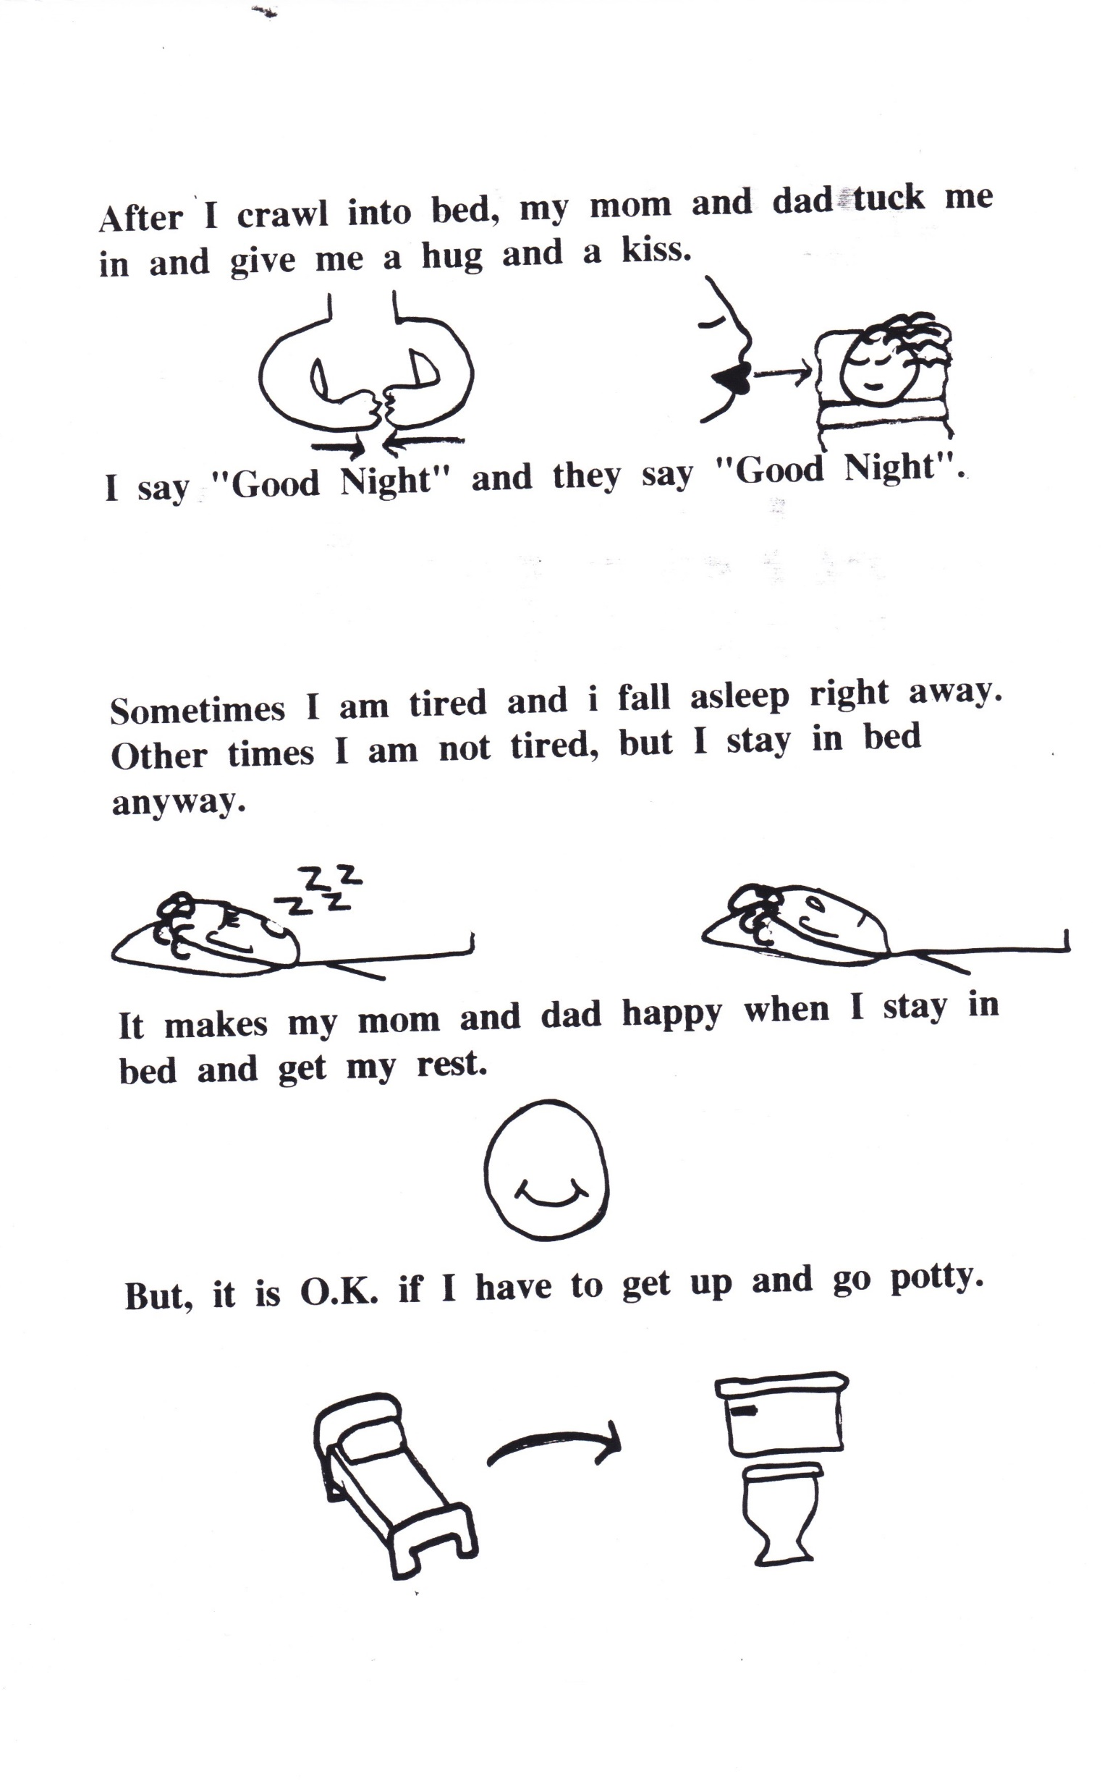
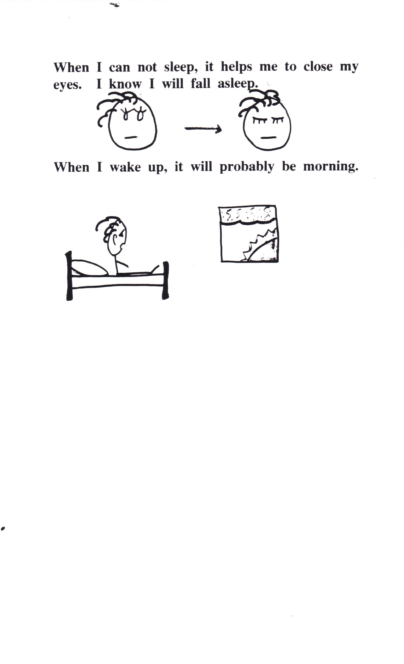

Slide 30
Sensory strategies
Heavy work tasks- Move chairs, lift books, wash table, carry books to another teacher, chewy candy/food, crunchy food, sharpen pencils, push cart, staple papers to bulletin board, climb on playground, swing, sport activities (running, jumping), do chair push ups, jump on mini-trampoline, push against wall.
Calming activities-Dimmed lights, calm music, calm smells, calm/low voice, rocking chair, lay on stomach propped on forearms, deep breathing, sensory calming bottles (glitter, small objects in water bottle filled with Karo Syrup sealed with glue!) fidget toys, play dough,

Slide 31
Sensory strategies continued
Alerting activities- Bright lights, fast music, alerting smells, alternate work positions, movement, bounce, jump, run errands, stretch between tasks, Simon says, Crunchy foods, cold water, sour candy, dance/freeze, hot potato with a weighted ball, clapping games.
Organizing activities- seat cushion, teacher assistant, jump on trampoline, fidget object, chair or wall push ups, push/pull theraband/ theraputty. Chewing gum, tubing on pencil top, suck hard candy, sensory play, weighted item, use structure-schedule board with consistent routine.

Slide 32
Tips for Success in Classroom
Reduce Sensory overload
Provide a structured Routine
Warn student ahead of time of expected changes/events
Use visual teaching strategies
Talk less, show more
Use concrete simple wording
Give choices instead of open-ended questions
Have direct explicit rules and expectations
Provide breaks
Teach social skills directly
Use special interests to motivate
Don’t sweat the small stuff, allow different styles
CELEBRATE SUCCESS no matter how small

Slide 33
Making schedules, picture communication, and sequencing cards
Find or take pictures with a computer or search online, (through Google images). Preference is to open a Power Point presentation, delete title boxes. Then go to insert in the tool bar, add picture on computer or search. Choose a picture, then insert. Resize the picture from the corners. Get needed pictures then print.
Laminate
Cut
Add Velcro if needed

